Slide 1
SSW-555: Agile Methods for Software Development
Scaled Agile Framework (SAFe)
Instructor: Dr. Nafiseh Ghorbani
Department of Systems Engineering
Stevens Institute of Technology

Slide 2
Acknowledgements
Some of the material in these slides is from:
"The Big Picture of Enterprise Agility" by Dean Leffingwell
https://scalingsoftwareagility.files.wordpress.com/2007/03/the-big-picture-of-enteprise-agilitywhitepaper.pdf
Scaling Software Agility Blog
https://scalingsoftwareagility.wordpress.com/

Slide 3
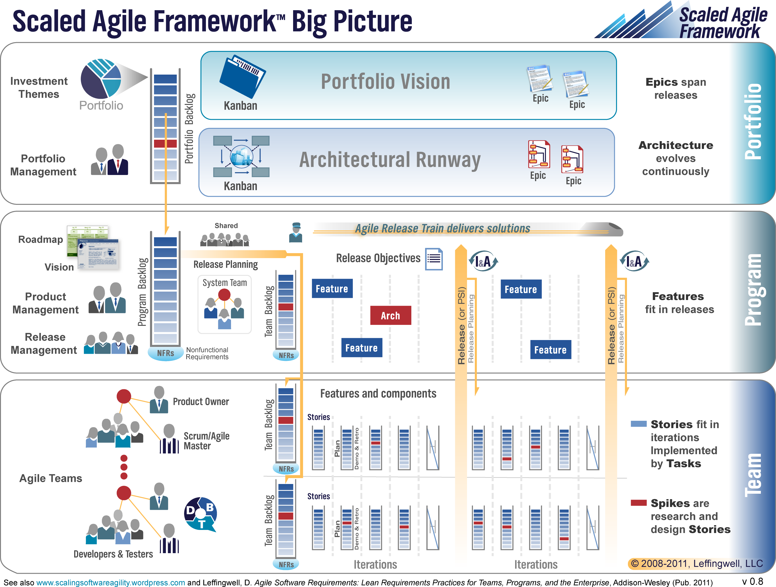
Today's topics
Scaling Agile and Scrum to larger projects
Overview of SAFe
Project Level of SAFe
Program Level of SAFe
Portfolio Level of SAFe

Slide 4
Overview of SAFe
General overview of what SAFe refers to:
Agile at Scale: SAFe applies Agile principles across large organizations.
Structured Methodology: It provides a clear approach for teams, programs, and portfolios.
Business Alignment: Ensures development aligns with strategic goals.
Defined Roles: Clear roles and responsibilities for better coordination.
Program/Portfolio Management: Manages complex initiatives across teams.

Slide 5
Overview of SAFe
General overview of what SAFe refers to:
Iterative Development: Uses sprints for incremental development.
Continuous Delivery: Focuses on fast, predictable releases.
Cadence & Synchronization: Regular schedules for planning and delivery.
Value Delivery: Prioritizes delivering value to customers.
Built-in Quality: Emphasizes quality throughout development.
SAFe helps organizations scale Agile practices to improve collaboration, efficiency, and value delivery.

Slide 6

Limitations of Scrum for large projects
Small teams
Self-directed teams - don't wait for instructions from the boss
Rely on face-to-face communication
Only short-term planning
No Big Design Up Front (BDUF)
FDD recommends JEDI (Just Enough Design Initially)
Isolated projects
Single Product Owner (Customer)
Answers developers' questions
Sets priorities and release dates

Slide 7

FDD recommends JEDI
Up-front modeling – "Just Enough Design Initially (JEDI)", to avoid refactoring
Bias toward getting it right the first time
FDD values documentation (models, notes, reference documents)
More emphasis on progress tracking and reporting
Dynamic feature teams
Chief Programmers vs developers
Design and code owned by individuals
Code inspections/peer reviews instead of pair programming

Slide 8
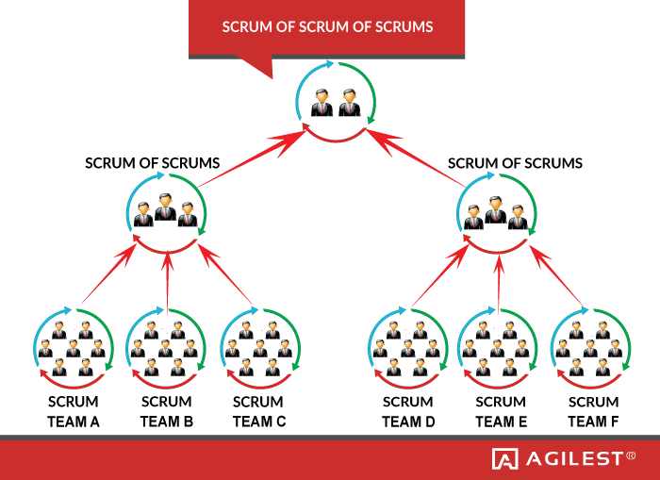
Scrum of Scrums: One solution
Scrum of scrums provides one technique to scale Scrum to larger projects
https://www.agilest.org/scaled-agile/scrum-of-scrums/

Slide 9
Overview of SAFe
https://scalingsoftwareagility.wordpress.com/

Slide 10
Three levels of organization
Level | Role | Title | Requirements
Portfolio | Long-term planning | Portfolio Manager | Theme/Epics
Program | Large system management | Product Manager | Epics/Features
Project | Traditional Scrum teams | Product Owner | User Stories

Slide 11
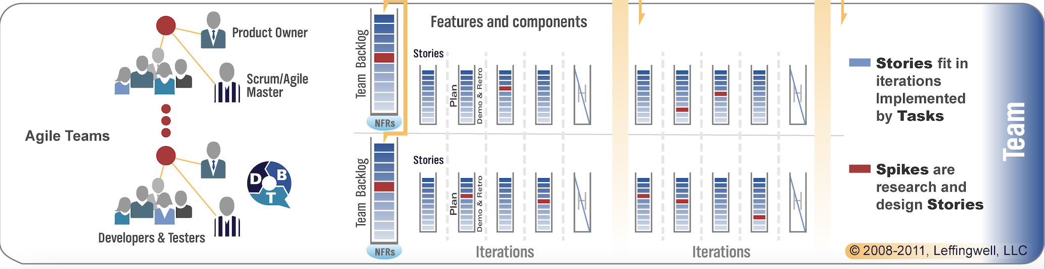
Project Level of SAFe
Agile teams define, implement, and test user stories.
Use Lean, Scrum and/or Kanban
Deliver components or features
Small enterprises may have a few teams
Larger enterprises may have “pods” of teams

Slide 12
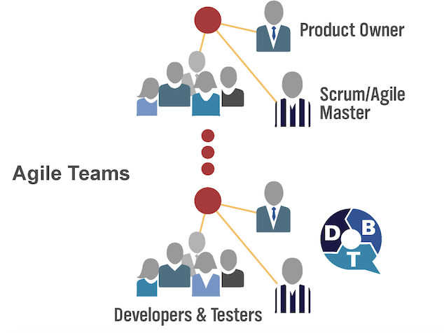
Project Level: Agile Teams
5-9 people
Organized around a single component or feature
Define user stories
Build
Test
May do acceptance testing
May be supported by specialists:
Architects
Technical writers
Internal IT

Slide 13
Project Level: Pods of Agile Teams
Larger systems may require groups of teams
Deliver features, systems/subsystems
3-10 teams cooperating with one another
50-100 people collaborating face-to-face
Each team primarily works alone but the other teams are readily available for collaboration

Slide 14
Project Level: Roles on Agile Teams
Product Owner
Determine and prioritize requirements
Maintain Product Backlog
Collocated with the team for daily interaction
Scrum/Agile Master
Train and coach team in use of Scrum
Act as "management/leadership proxy”
Product management role
Developer
Define, build, test and deliver software
May include "full or part-time architects, tech leads, user experience and documentation experts"

Slide 15
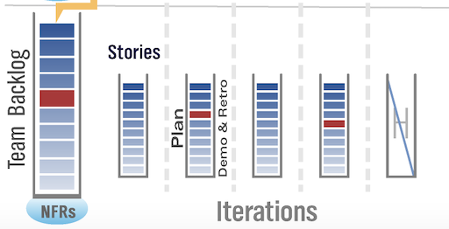
Project Level: Iterations (Sprints)
Standard time-boxed intervals
Iteration length is same for all teams
Typically, 2-4 weeks
Need to integrate modules across teams
Features may slip to meet time-boxed intervals
Must meet quality goals
Each release contains:
4-5 development iterations/sprints
1 "hardening" iteration - resolve integration problems, etc.
Fully shippable increment every 90 days or so

Slide 16
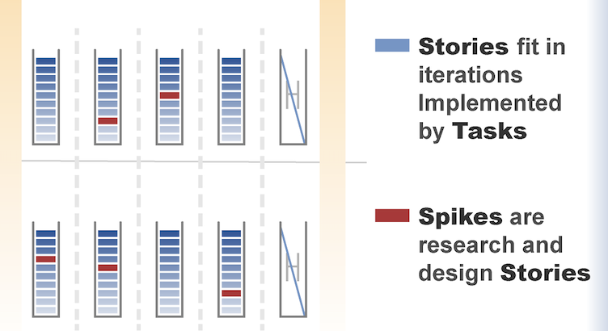
Project Level: User stories and tasks in the backlog
Each team has its own Iteration Backlog:
User stories
Defects
Refactoring
Spikes
Stories may be decomposed into Tasks for estimation and tracking

Slide 17
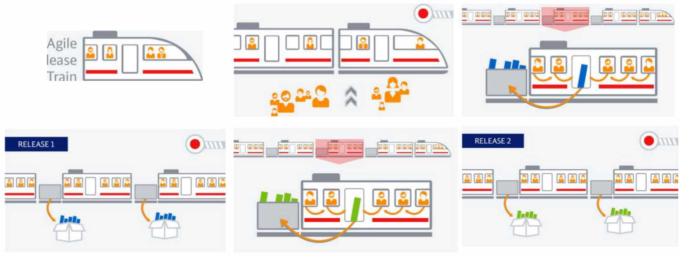
Project Level: .Agile Release Train
Multiple Agile teams delivering functionality
Time boxed iterations with quality requirements.
Features in each release may change to meet the schedule.
Deliveries are made every time the train “enters the station”.

Slide 18
Project Level: .Agile Release Train
The rectangular box moving from one train car to a previous one represents:
Feedback and rework between teams (iterations), not strictly one-way flow
Something wasn’t quite right, so we’re sending it back to improve or adjust before continuing.
In SAFe, teams don’t just pass work forward like a waterfall. Instead:
Work flows forward as features are developed
But sometimes, feedback or issues are discovered
That causes work to go back to a previous team or iteration for refinement, fixes, or alignment

Slide 19
Project Level: .Agile Release Train
At the project/program level:
Multiple teams work in parallel (like train cars)
Continuous integration, testing, and feedback happen
Learning loops are expected-not a straight line
So, the picture is emphasizing:
SAFe is iterative and collaborative, not linear
Feedback loops are normal and necessary for quality

Slide 20
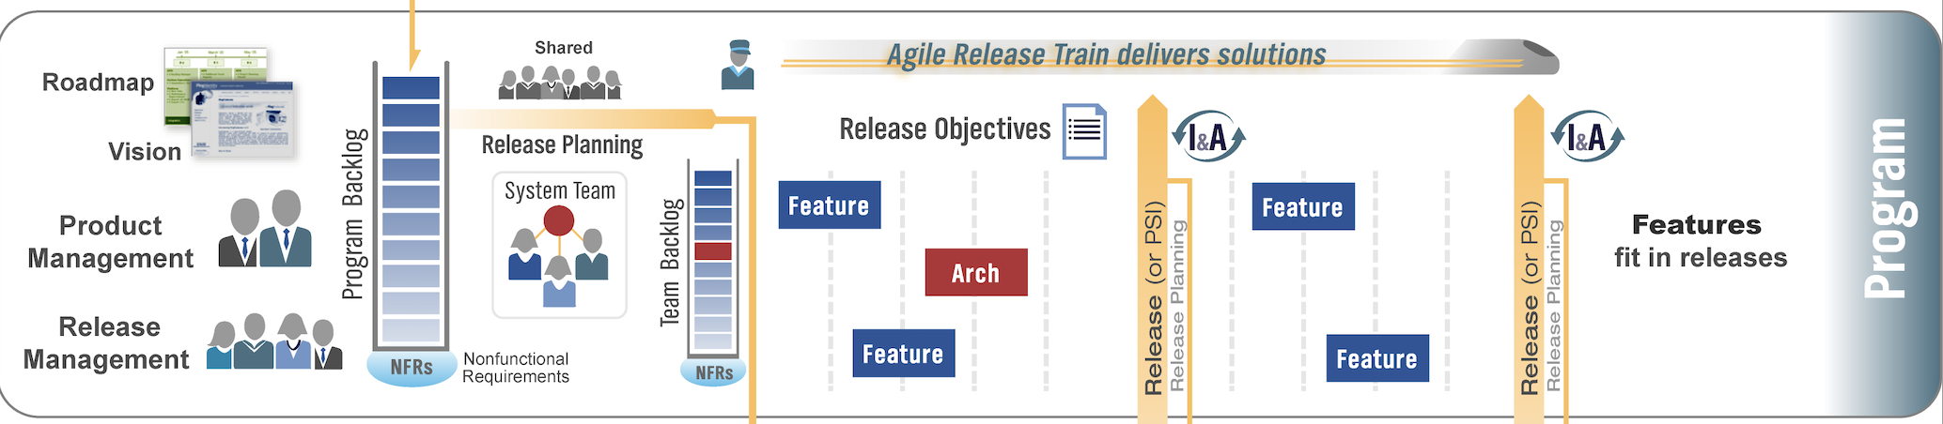
Program Level of SAFe
System team and Release management team
System level testing and release evaluation
Coordinate work of Agile Teams in the Project Level
Understand how the work should evolve over time

Slide 21
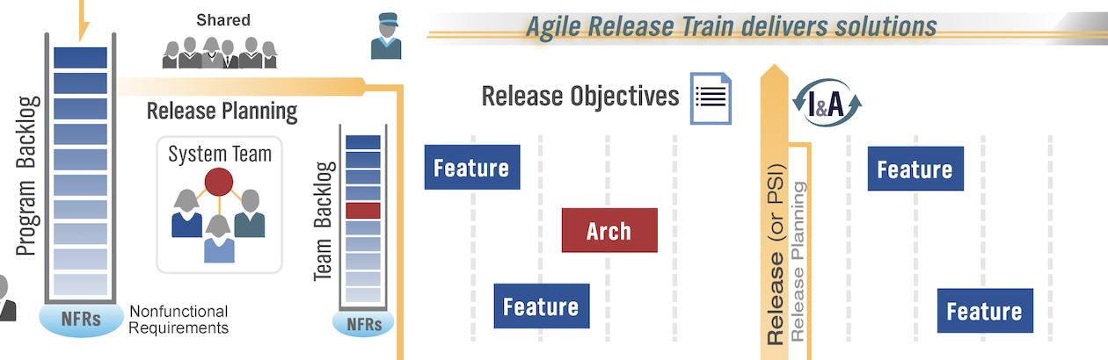
Program Level: Releases
Each iteration produces a “potentially shippable increment”
Typically, 2–4-month intervals between releases
Recall that the Agile teams are using 2-week sprints
May not want to release every increment to customers:
Defects, refactoring to remove technical debt
May interfere with customer's licensing and service agreements
Potential disruption to customer

Slide 22
Program Level: Releases
Releasing every increment of a software product isn't ideal in a Scaled Agile Framework (SAFe) program level.
Defects: Releasing every increment could mean shipping features with unresolved bugs or issues that would negatively affect customers.
Refactoring to remove technical debt: Sometimes, teams need time to improve the internal quality of the software (refactoring), and releasing new increments might interfere with that process, leading to a suboptimal product.

Slide 23
Program Level: Releases
Releasing every increment of a software product isn't ideal in a Scaled Agile Framework (SAFe) program level.
Customer Licensing and Service Agreements: Frequent releases could conflict with existing agreements or terms with customers, such as specific release schedules, versions, or service commitments.
Potential Disruption to Customers: Too many releases can disrupt customer operations, causing unnecessary updates, changes, or training needs, potentially making the product harder to use or integrate.
While delivering value incrementally is important, it’s also necessary to balance it with stability, quality, and customer impact.

Slide 24
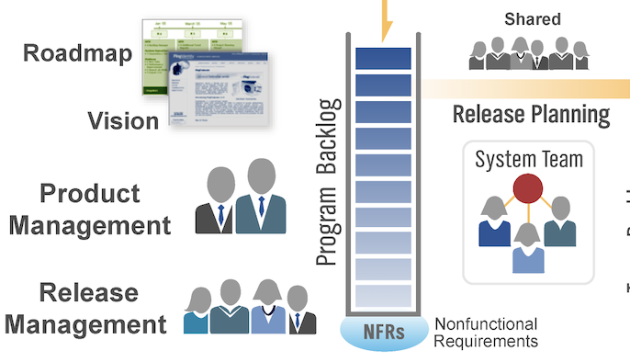
Program Level: Vision and features
Product Managers are responsible for overall Vision
The Vision answers:
What problem does this solve?
What features and benefits does it provide?
For whom does it provide it?
What performance, reliability, etc. does it deliver?
What platforms, standards, etc. will it support?
Technical and marketing issues
Release Backlog consists of prioritized features
Features later refined into stories
Release Backlog contains all desired features that haven’t been delivered yet

Slide 25
Program Level: Vision and features
Specify non-functional requirements: “*ilities”, focusing on aspects of the system that describe how the system should perform, rather than what it should do.
These requirements are critical for the system's quality and overall user experience.
Scalability: The ability of the system to handle growth, such as an increase in users, data, or transactions, without degrading performance.
Reliability: The system’s ability to consistently perform as expected, without failures, and recover quickly when problems occur.
Availability: The amount of time the system is operational and accessible to users, often expressed as a percentage (e.g., 99.9% uptime).
Performance: How quickly the system responds to user requests or processes data, including response times and throughput.

Slide 26
Program Level: Vision and features
Security: The system’s ability to protect data and resources from unauthorized access, vulnerabilities, or attacks.
Maintainability: The ease with which the system can be updated, fixed, or extended over time without introducing new problems.
Usability: How easy and intuitive it is for users to interact with the system, including design, accessibility, and user experience.
Portability: The ability of the system to operate across different platforms or environments with minimal changes.
These "ilities" are essential to ensure the system's overall quality and to meet customer expectations.
They're often considered during planning and design phases, but they can evolve and need to be monitored throughout the development lifecycle.

Slide 27
Program Level: Release planning
Product Managers are responsible for Release Planning:
Analogous to Sprint Planning
Identify time box with typically multiple sprints
Hold Release Planning meeting
Use vision and business objectives to identify prioritized list of features to include in next release
Create a Roadmap to describe the “plan of intent”

Slide 28
Program Level: Release planning
Create a Roadmap to describe the “plan of intent”
A strategic, high-level plan that sets the direction for delivering features and capabilities over time.
It's not a detailed schedule but rather a guiding document that shows what is planned and when it's anticipated to be delivered.
The plan of intent roadmap provides a strategic view of the program's upcoming releases and goals, but it's not a rigid, detailed schedule, it’s flexible and subject to change.

Slide 29
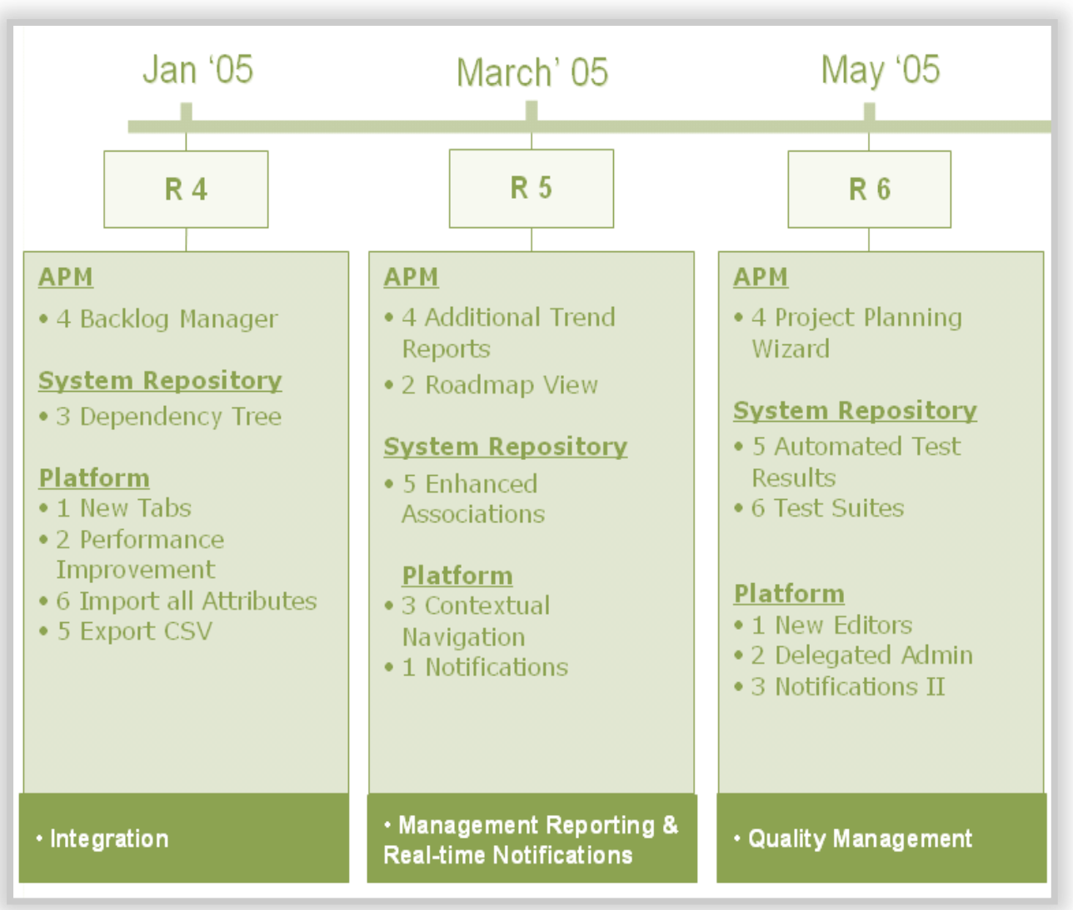
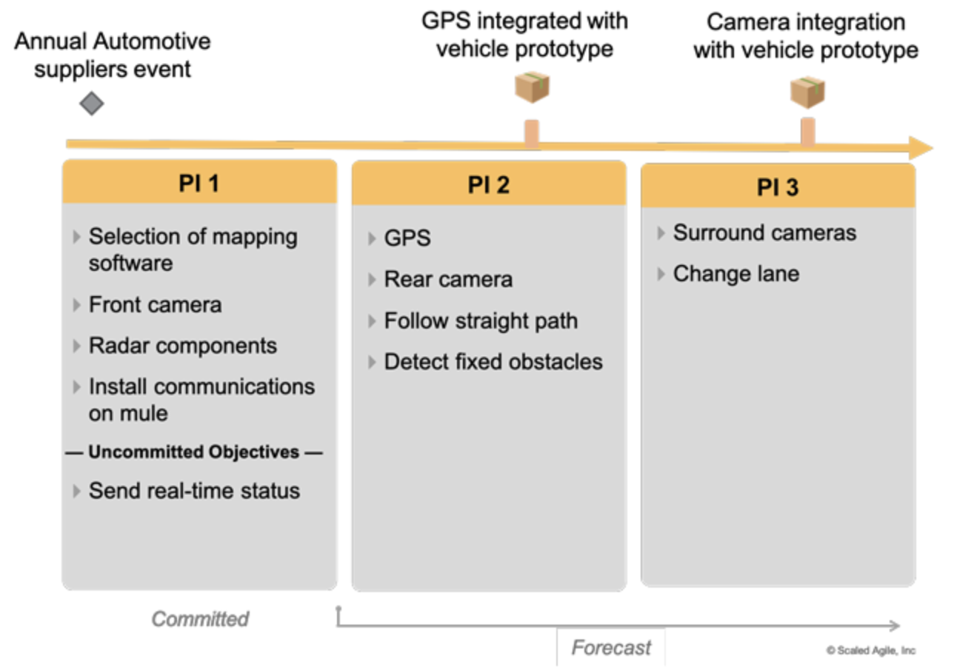
Program Level: The Roadmap
Release planning breaks features into stories
Stories assigned to teams
Interdependencies are identified and addressed
Result is a Roadmap:
Planned release dates
Each release includes:
Theme
Objectives
Set of features
https://www.scaledagileframework.com/roadmap/

Slide 30
Program Level: Product Management
Scrum Product Owners:
Represent the interests of everyone with a stake in the resulting project
Achieve initial and ongoing funding
Create initial requirements, return on and release plans
SAFe Product Managers responsibilities are broader:
Define the product
Position the solution in the market

Slide 31
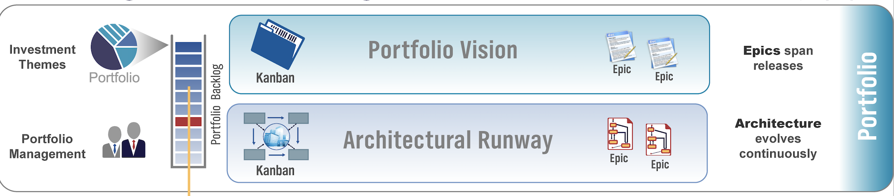
Portfolio Level of SAFe
Portfolio Managers responsibilities:
Manage enterprise investments
Manage enterprise resources
Investment themes
Epics

Slide 32
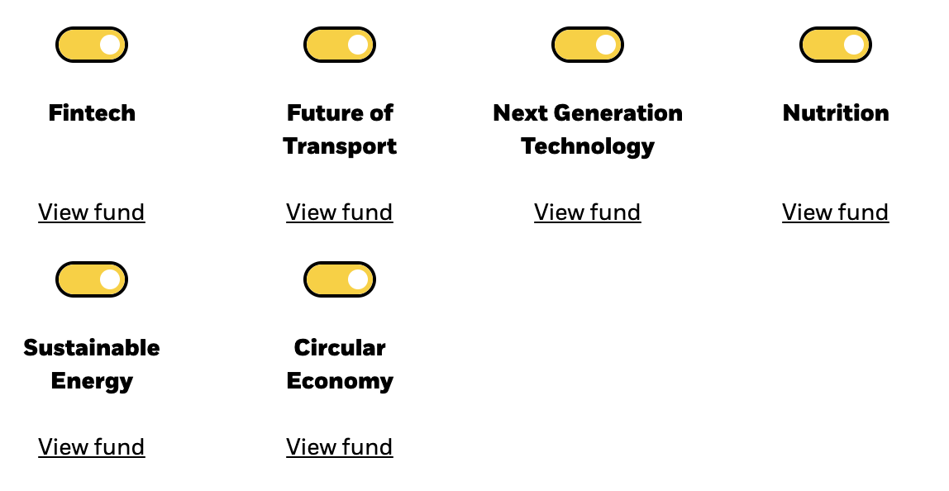
Portfolio Level: Investment Themes
Large enterprises make decisions once or twice per year on investment themes:
Existing offerings (enhancements, support and maintenance)
New offerings
Futures - require investment now, but will not contribute toward revenue until later
Sunset - end support for existing products and services
Themes: how should the enterprise allocate financial and other resources?
https://www.blackrock.com/lu/individual/themes/thematic-investing/why-invest-thematically

Slide 33

Portfolio Level: Investment Themes
Themes identify key value propositions
Differentiate the company’s products
Provide competitive advantage
Themes may span multiple years

Slide 34
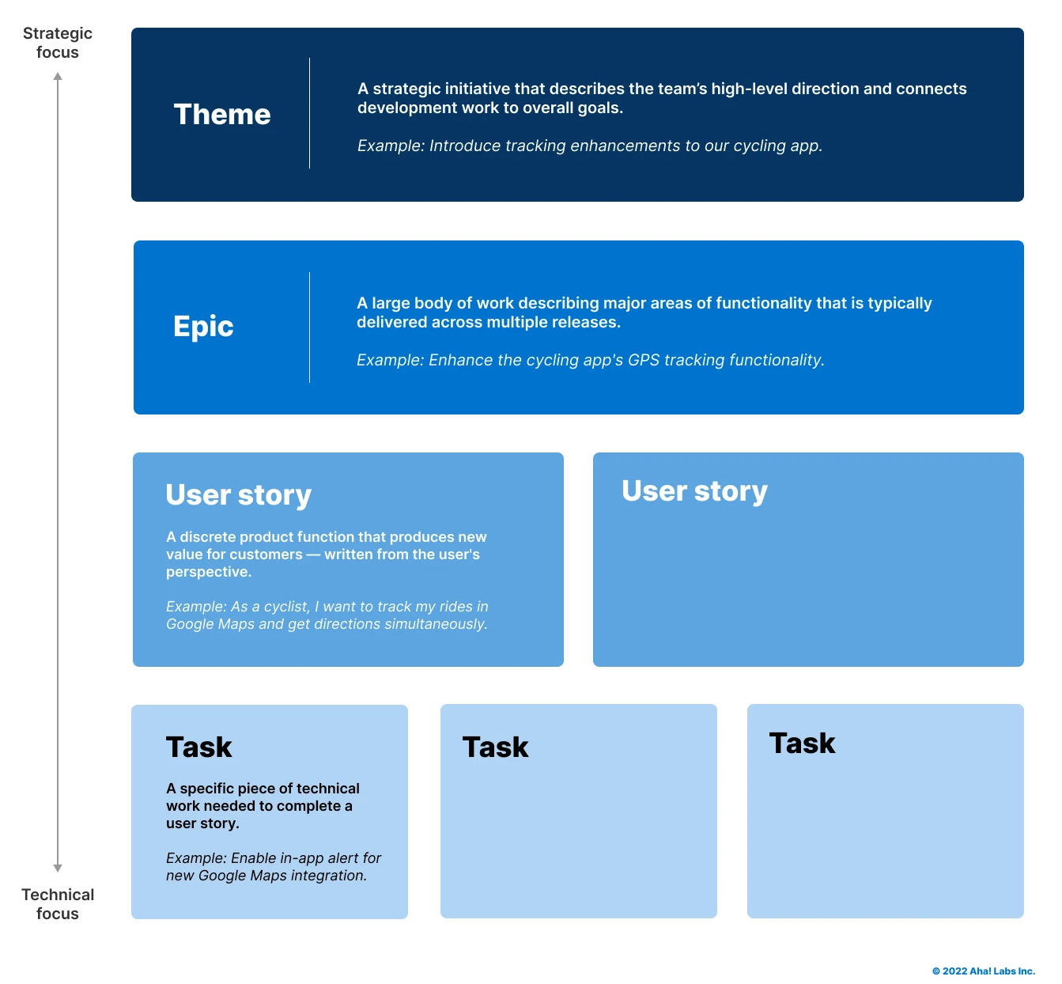
Portfolio Level: Epics, Features, Stories, Tasks
Themes are later defined as Epics in the Portfolio Backlog
Epics describe strategic intent
Epics are further refined into Features
Features are broken into Stories
Stories are broken into Tasks
https://www.aha.io/roadmapping/guide/agile/themes-vs-epics-vs-stories-vs-tasks

Slide 35
Three levels of backlogs
Level | Backlog | Contents
Portfolio | Portfolio backlog | Backlog of prioritized epics describing strategic intent
Program | Release/product backlog | Backlog of prioritized features
Project | Iteration backlog | Backlog of user stories aligned to business needs

Slide 36
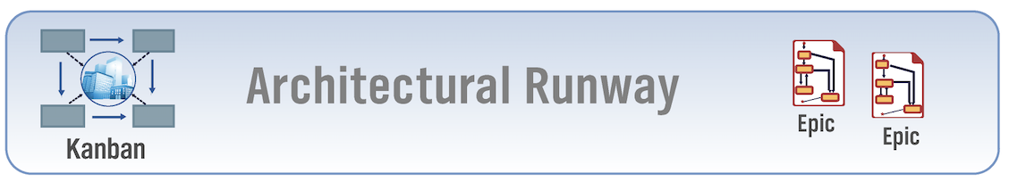
Portfolio Level: Architectural Runway
"A system with architectural runway has existing or planned infrastructure sufficient to allow incorporation for current and near-term requirements without excessive refactoring.” – Leffingwell
Refers to ensuring that the infrastructure and architecture are already in place or are being planned in a way that supports future development without major overhauls.
Existing or Planned Infrastructure: The system has the necessary architecture or plans to support future needs.
Supports Current and Near-Term Requirements: The architecture can handle ongoing and upcoming features.
Minimizes Refactoring: It avoids major changes or overhauls to integrate new features.
Scalable and Flexible: The system can grow and adapt easily without delays.
Facilitates Continuous Delivery: It allows for smooth, ongoing feature delivery.
Reduces Technical Debt: Proper planning prevents costly rework in the future.

Slide 37
Portfolio Level: Architectural Runway
A well-prepared architectural runway is about having a solid, flexible infrastructure in place that supports current and future requirements without needing major rework or disruption as new features are introduced.
An architectural runway ensures the system can evolve without significant refactoring or delays.
Failure to maintain architectural runway may lead to:
Missed release dates due to large-scale refactoring
Slowed velocity
Inability to create new features

Slide 38
Portfolio Level: Architectural Runway
Architectural Runway spans all three levels
Portfolio
Infrastructure initiatives
Architectural epics
Program
Architectural features for releases
Project
User stories

Slide 39
SAFe Summary
Resource investment vision
Overall architecture
Manage large organizations
Focus on releases to meet customer needs
Traditional Scrum/Kanban teams
Optional pods

Slide 40
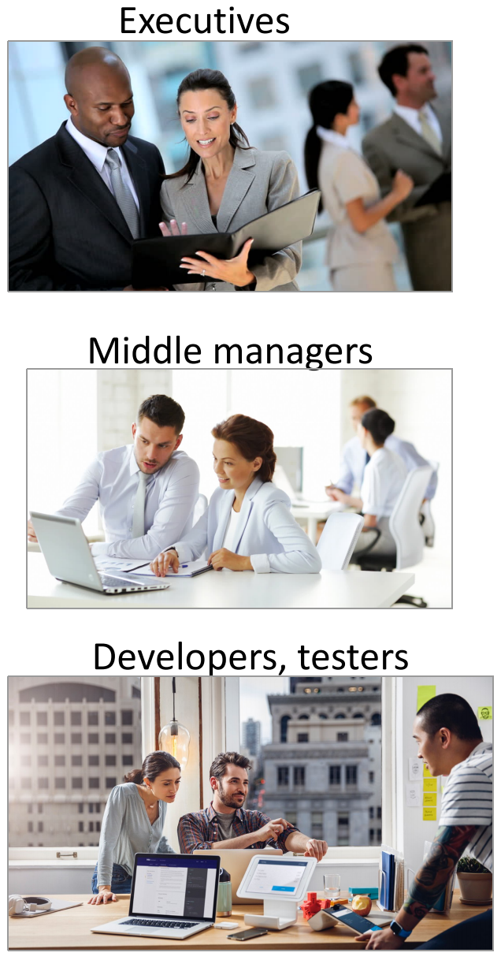
SAFe Summary

Slide 41

Questions?

